Slide 1
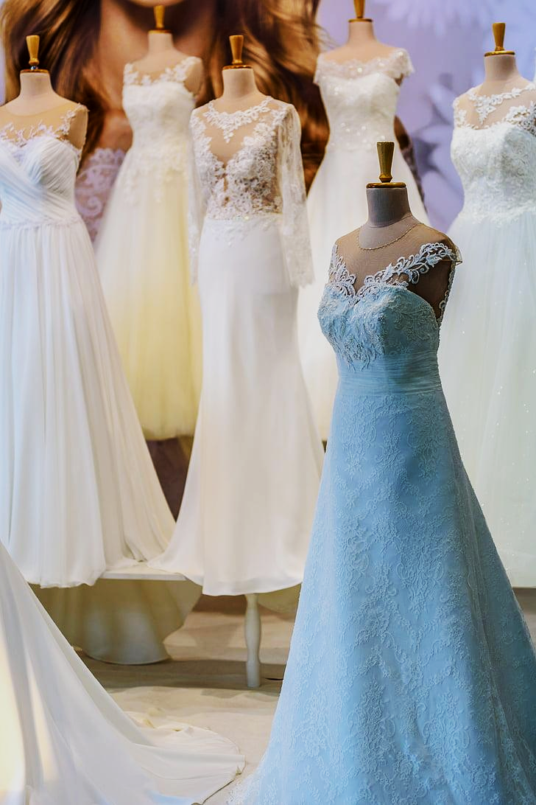
EDonna Bridal Couture
Executive Summary

Slide 2
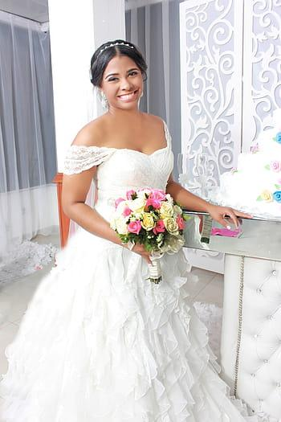
WHO WE ARE
EDonna Bridal Couture is a premium wedding gown design and retail venture that specializes in creating exquisite, custom-made bridal gowns for modern brides. Our business is dedicated to providing brides with personalized service, offering a wide range of high-quality, elegant, and timeless gowns. Based on current market trends, we blend contemporary fashion with traditional craftsmanship to deliver unique gowns that reflect each bride's style and personality.

Slide 3
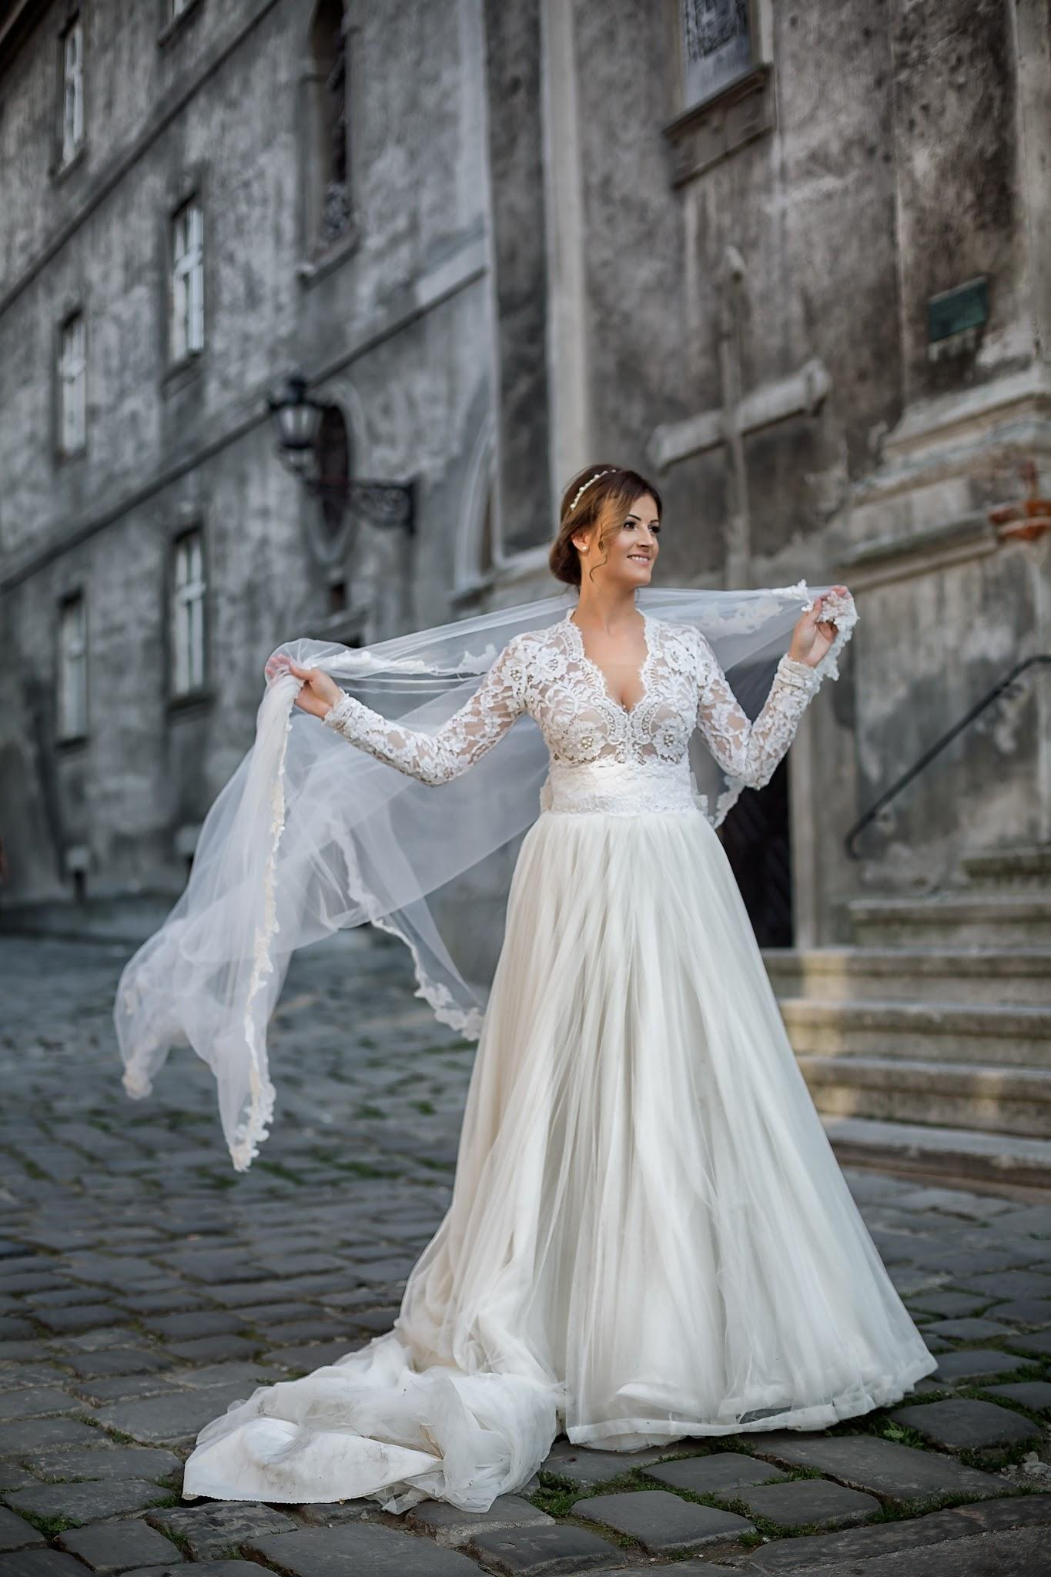
MARKET OPPORTUNITY
The wedding industry continues to grow, with brides increasingly seeking customized, high-quality gowns that make a statement. There is a significant demand for bridal wear that offers uniqueness, personalized attention, and a perfect fit. EDonna Bridal Couture will cater to this niche by offering exclusive, handcrafted gowns that stand out in the market.

Slide 4
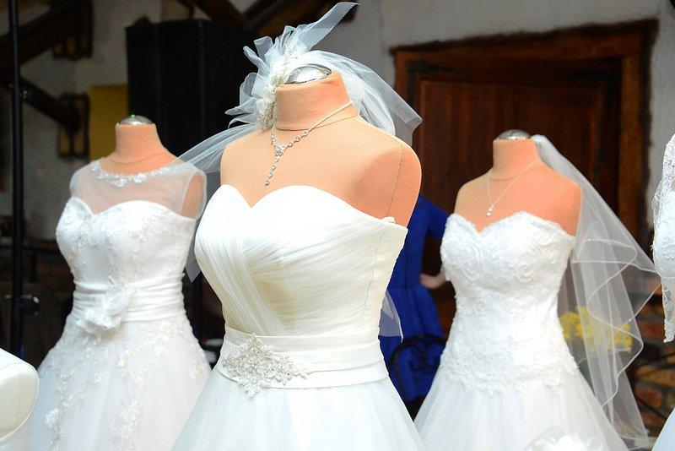
OUR PRODUCTS & SERVICES
Custom-made bridal gowns tailored to individual preferences
Ready-to-wear wedding gowns in various sizes and styles
Bridesmaid dresses and accessories to complement the bridal ensemble
Alteration services to ensure a perfect fit

Slide 5
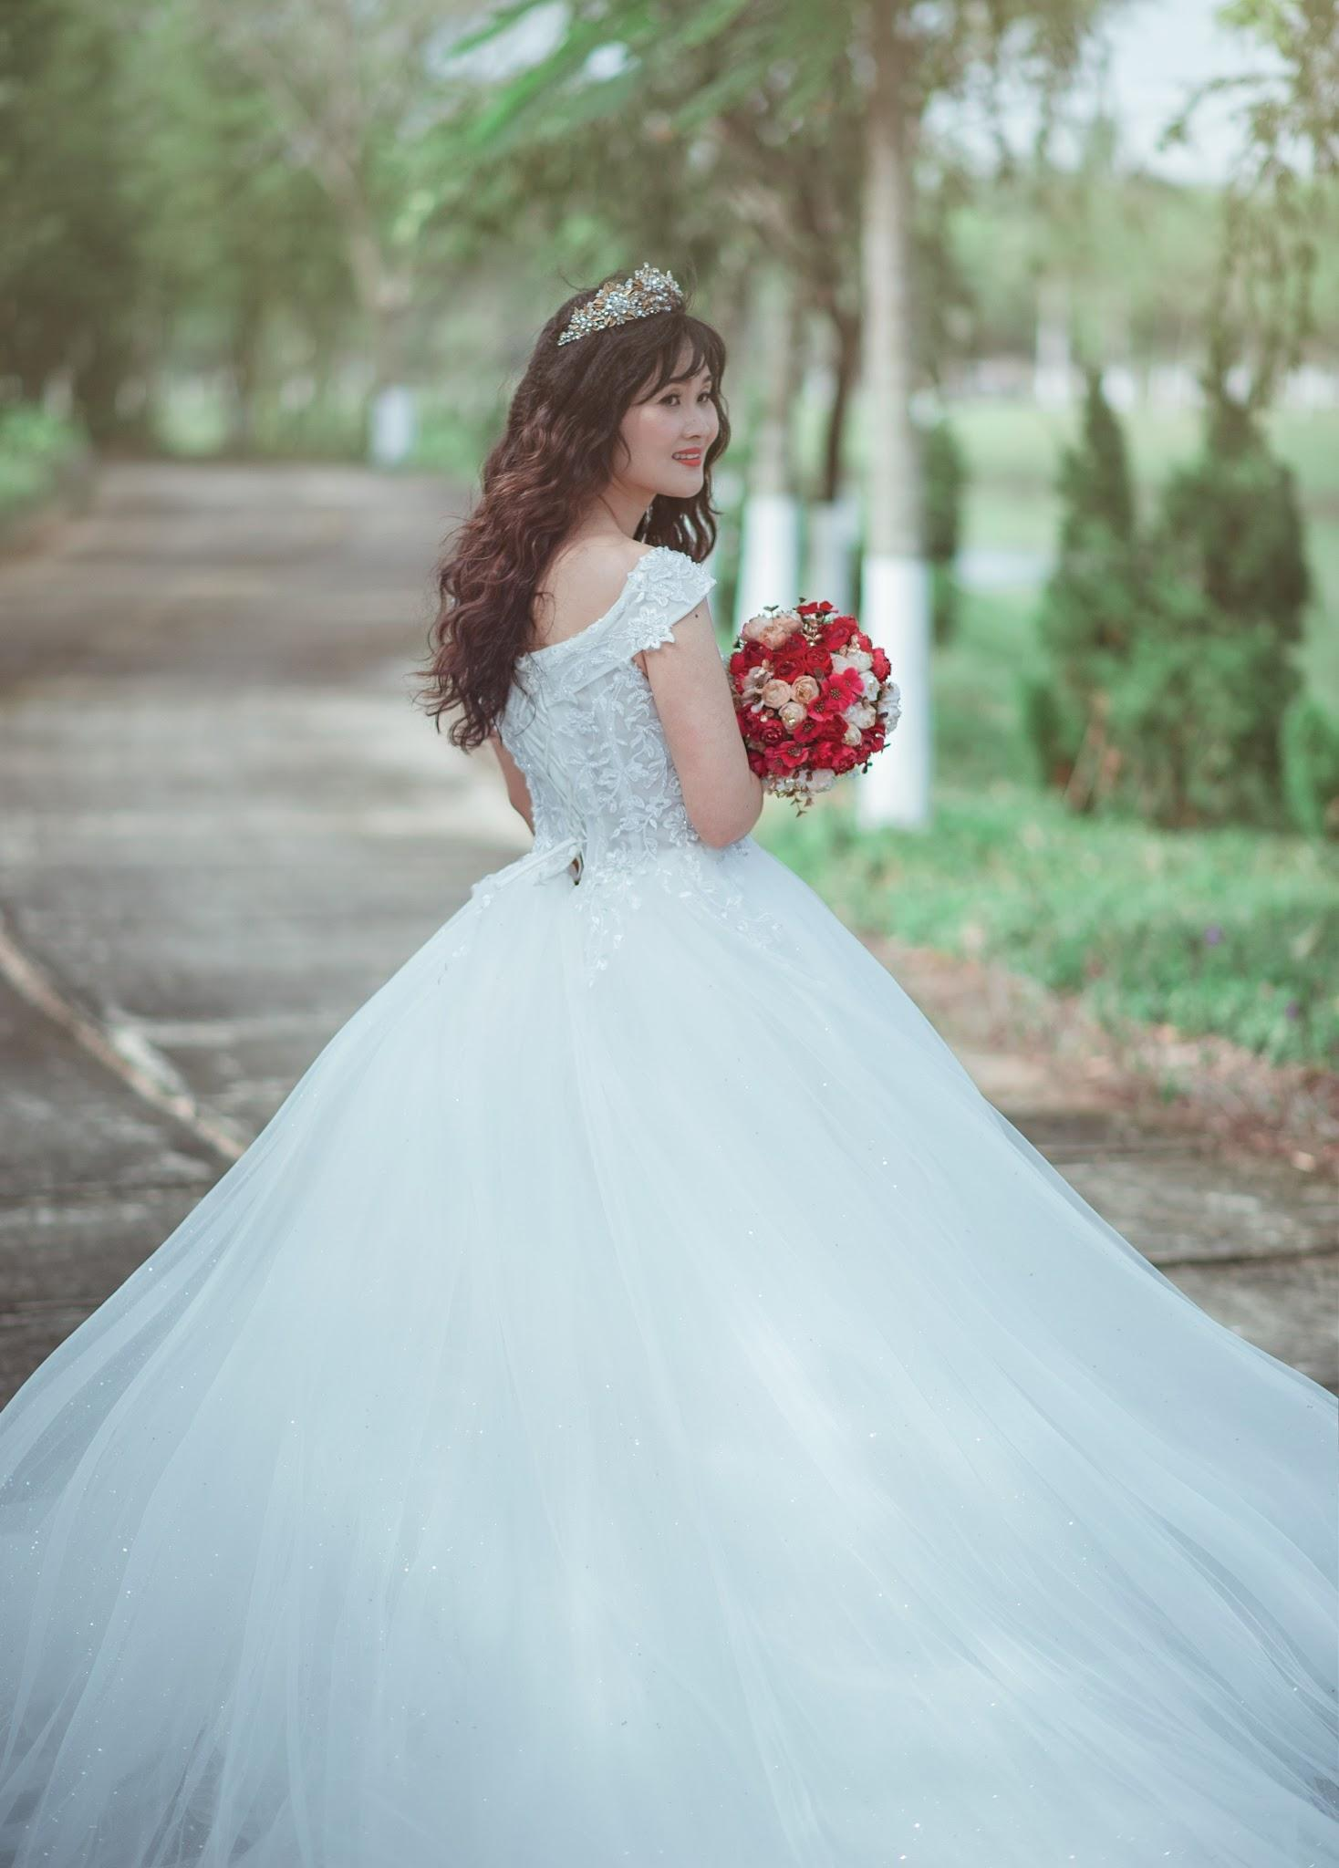
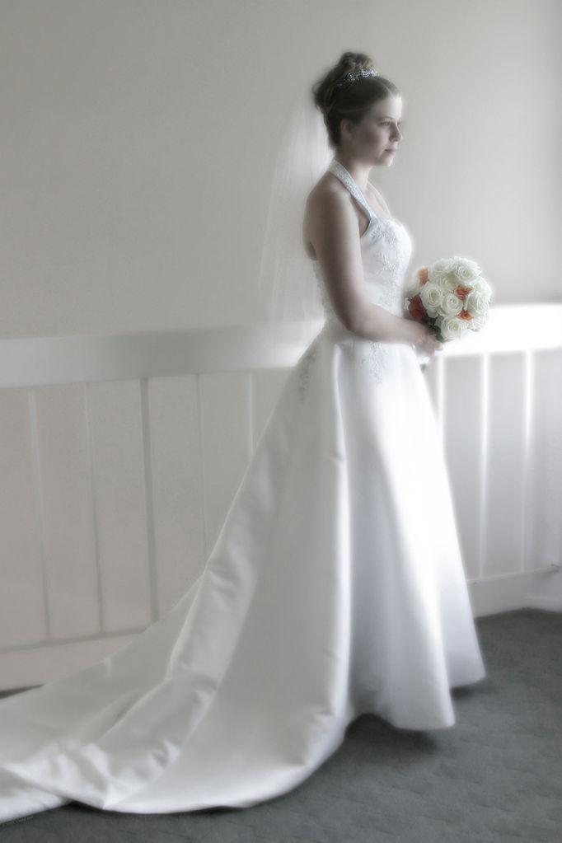
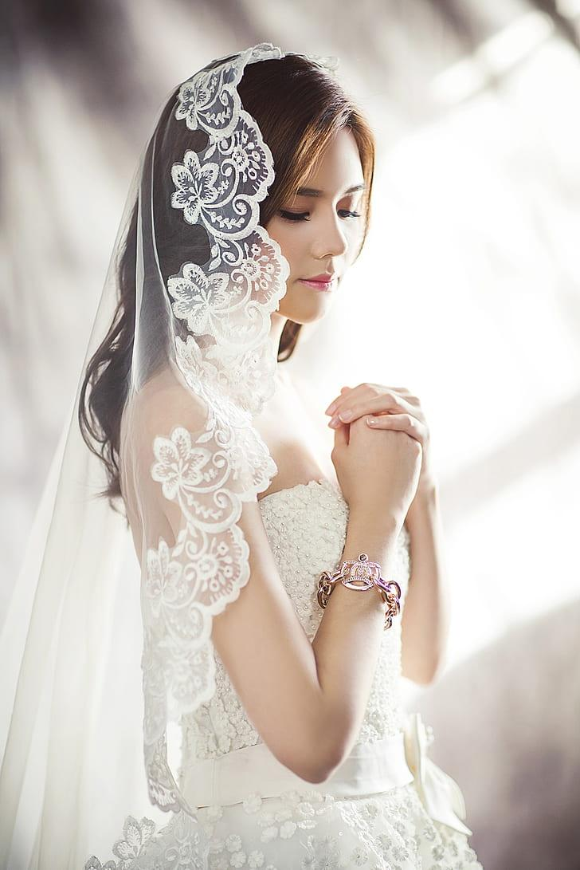

OUR TARGET MARKET
Our target market consists of brides aged 24 to 35 who are willing to invest in high-end, unique, and personalized wedding gowns. We will focus on urban areas with a higher concentration of premium wedding services and clients seeking bespoke bridal experiences.

Slide 6
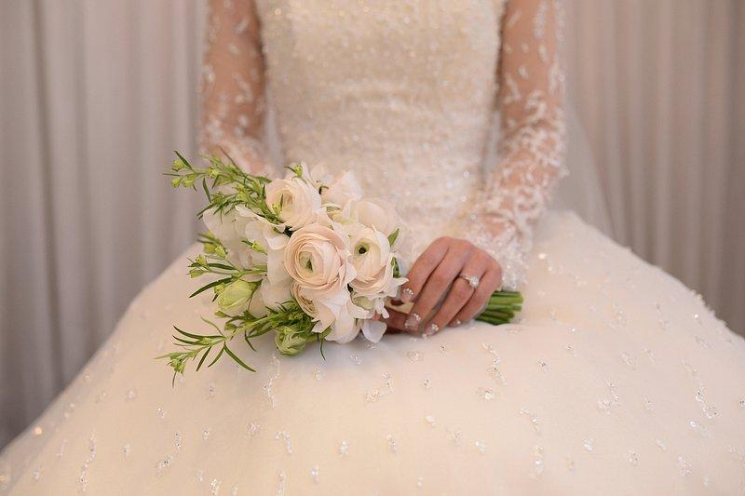
FINANCIAL HIGHLIGHTS
We project to break even within the first year, with a steady revenue stream from both custom orders and ready-to-wear collections. The business aims to achieve a gross profit margin of 50% within the first three years, supported by premium pricing and repeat customers through word-of-mouth and online marketing.

Slide 7
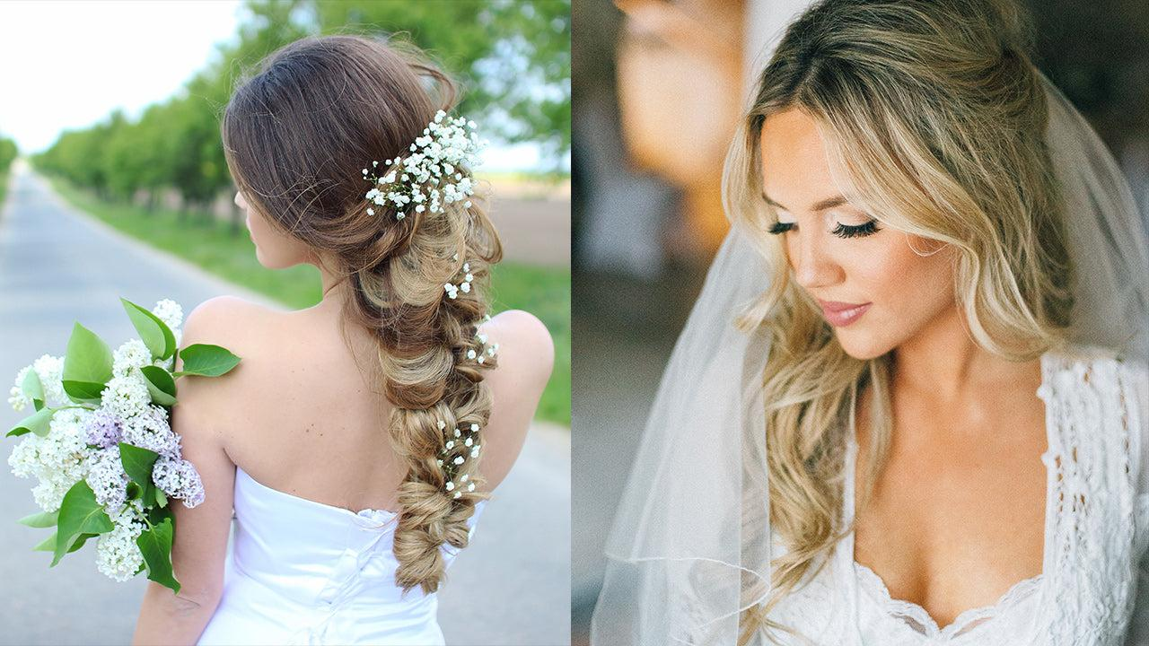
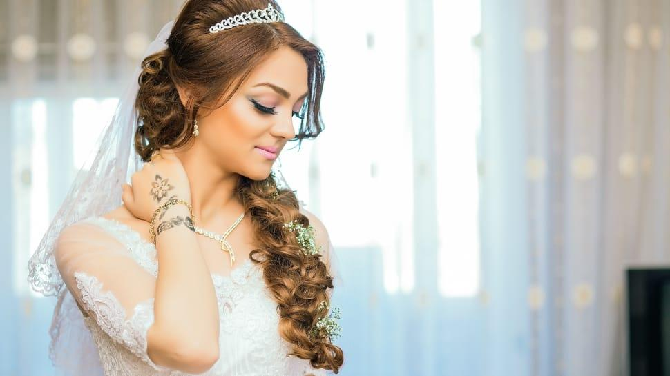
CONCLUSION
EDonna Bridal Couture is positioned to capture a share of the growing bridal market by offering unmatched designs, personalized service, and a luxurious experience for brides on their special day. Our vision is to become a leading name in the high-end bridal wear industry, known for our craftsmanship, attention to detail, and dedication to creating unforgettable bridal moments.

Slide 8
THANK YOU!!!

